Slide 1


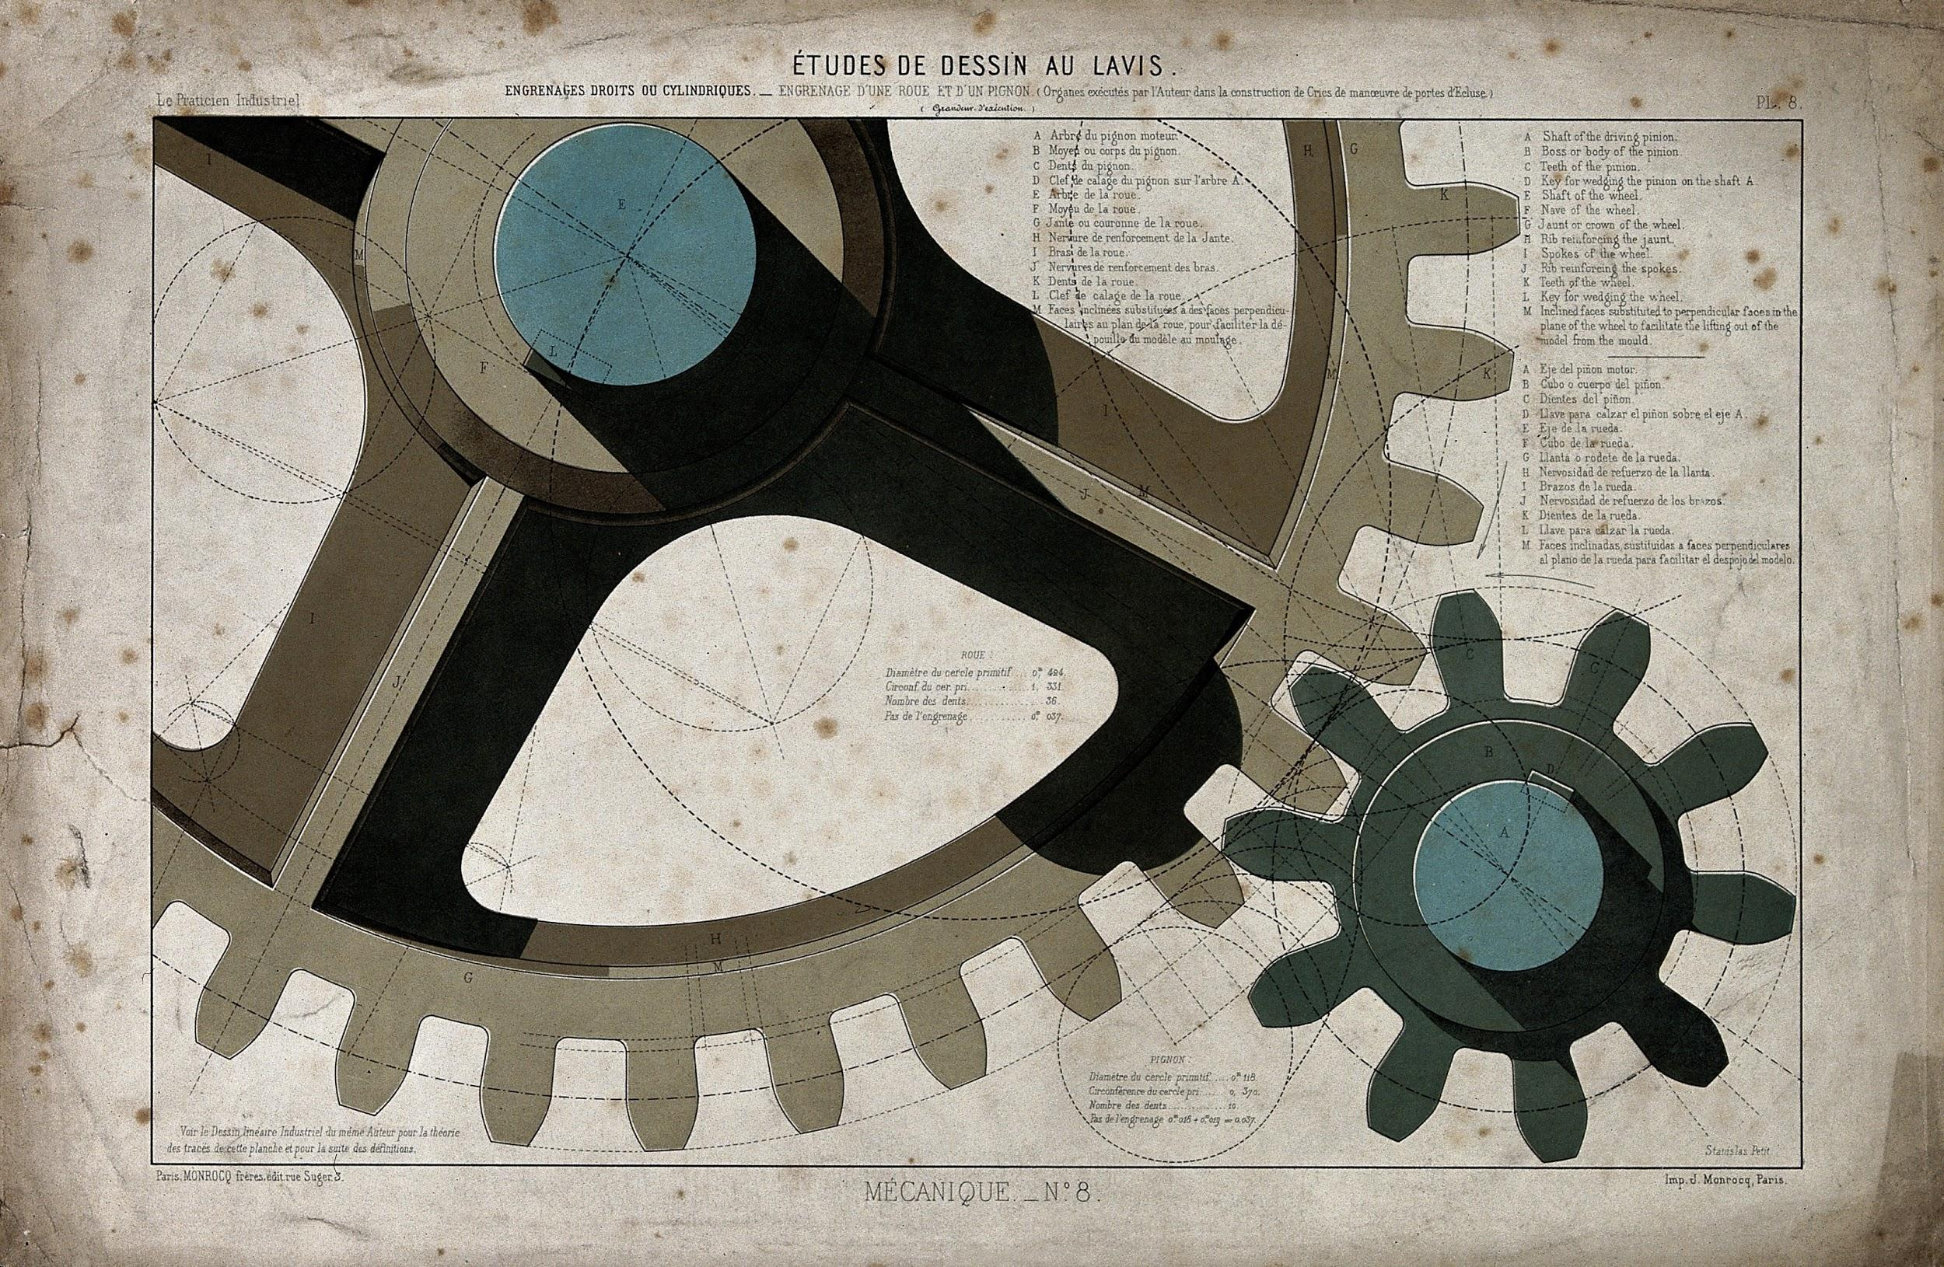

Medina Middle School
STEM Club
Science
Technology
Engineering
Math
We are seeking new members for the 2020-2021 School Year
For fun and exciting projects relating to STEM
Contact Mrs. Simmons or Mrs. Taylor for more information
Through Google Classroom

Slide 2
If you are really interested:
Go to classroom.google.com
Class Code: v7fhewr
Medina Middle STEM Club

